Slide 1
DATA STRUCTURES
B-Tree

Slide 2
Session Objectives
To learn about B-Tree, insertion and deletion operations
Notes:
Student Notes:
The objective of the session is to introduce the concept of services and how these are management. There are standards and frameworks that enable the organization to manage the services. These are also introduced in this session.

Slide 3
Session Outcomes
At the end of this session, participants will be able to
Understand the concepts of Btree, Insertion and Deletion operations

Slide 4
Agenda
Disk structure
How data is stored on the disk?
Indexing
Multilevel Indexing
Multi-way search tree
Btree
Insertion operation
Deletion operation

Slide 5

B-Tree, Insertion, Deletion operations
Dr. B. Prabavathy
SSNCE

Slide 6
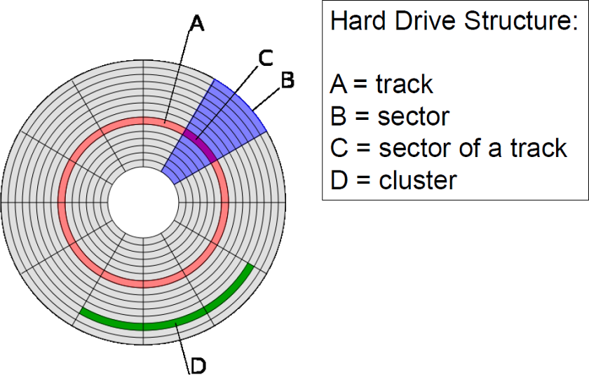
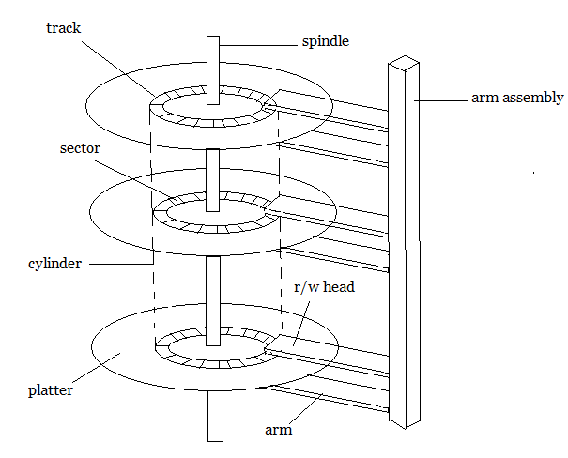
Disk structure
Logical concentric circles represent tracks
Each track is numbered 1, 2, 3, ...
Similarly sectors are also numbered
Intersection of track and sector (For ex. Here C is a disk block)
Any block in the disk is identified by (Track number, Sector number )
Any location in the block (0 .. 511) (Block address, location address )
By spinning the spindle, sectors are changed
By arm movement, the tracks are changed

Slide 7
How the program gets executed?
Main memory
RAM
Program and data obtained from the disk to the memory
Organizing the data in main memory which can be directly utilized by the program is data structure
Disk
Data is stored in terms of blocks
Organizing the data efficiently in the disk to access them is DBMS

Slide 8
How the data is stored in the disk?
Record consists of the following fields
Eid – 10
Name – 50
Dept. – 10
Section – 8
Address – 50
Total – 128 bytes
We have file that consists of 100 records
In a block, we can store (512/128) 4 records
We store the entire file in 25 blocks
So, if we want to search, For ex, the record of ‘Smith’ in the disk, we need to search 25 blocks.

Slide 9
Indexing
Possible to reduce the searching time by the development of index
Index
1st entry has Eid ptr to block1 (Record pointer)
2nd entry has Eid ptr to block1 (Record pointer)
3rd entry has Eid ptr to block1 (Record pointer)
4th entry has Eid ptr to block1 (Record pointer)
5th entry has Eid ptr to block2 (Record pointer)
.
.
100th Eid ptr to block25 (Record pointer)

Slide 10
Indexing
Where we will store the index?
Index in disk
Eid takes 10 bytes, Record pointer takes 6 bytes, So total = 16 bytes
100 entries will be there in the index table
Each entry, 16 bytes, so total = 100 * 16 bytes = 1600 bytes
(1600/512) will take 3.125 blocks ~ 4 blocks
So in order to search for the record named “Smith” , first we will search for the index which is there in 4 blocks and then the block where the record is present.
Requires 4 + 1 blocks to search in spite of 25 blocks

Slide 11
Multilevel indexing
If the number of records grow, for example 1000 records
Then the index alone will have 1000 entries
So, index itself will be stored in 40 blocks
In each block, 32 entries are possible
We can prepare second level index that will have a pointer to the index block
So, in multilevel index, it is enough to look at 2 blocks (1st level and 2nd level)
This is the basic idea for originating B and B+ trees
We want the high level indices are automatically added or deleted depends upon the data
We need self managed high level indices

Slide 12
M-way search tree
B trees and B+ trees are originated from M-way search tree
B tree is self-balancing data structure
Binary search tree
Smaller keys – left side
Larger keys –right side
How many keys can a node in BST have?
One key
How many children can a node in BST have?
2 children
Can we have more than 2 children and more than 1 key?
Yes, if it is so, that is m-way search tree
BST is a type of m-way search tree with the degree 2

Slide 13
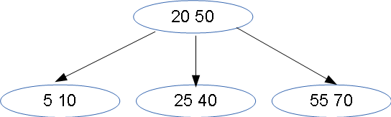
M-way search tree
Each node can hold n keys and m children
If the key 25 has to be found, it will be searched in the root.
It finds that it is greater than 20, so it will use the middle pointer to retrieve the node and search for 25.
M is called M-way, or order or degree of the tree

Slide 14
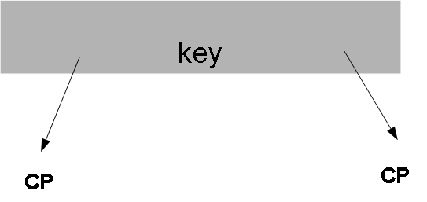
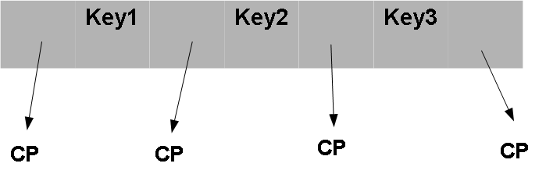
Node structure for M-way search Tree
BST has 1 key and 2 children
4-way search tree
4children and 3 keys
CP is child pointer

Slide 15
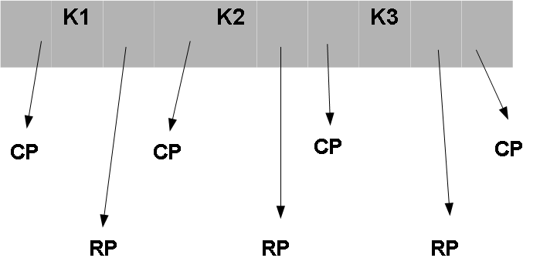
Can we use this search tree for making an index?
Yes, add one more field to add record pointer in addition to child pointer

Slide 16
What is B Tree?
Can we simply use M-way tree structure?
No, because the creation process for M-way search tree has no guide lines.
B trees are m-way search trees with guidelines for creation
Creation process is bottom up
DEF: A B Tree of order m is an m way tree such that
All leaf nodes are at the same level.
All non leaf nodes (except the root) have at most m and atleast m/2 children.
Number of keys is one less than the number of children
Root may have as few as 2 children unless the tree is the root alone.

Slide 17
Why B Tree?
Reduces the number of reads made on the disk
B Trees can be easily optimized to adjust its size (that is the number of child nodes) according to the disk size
It is a specially designed technique for handling a bulky amount of data.
It is a useful algorithm for databases and file systems.
A good choice to opt when it comes to reading and writing large blocks of data

Slide 18
Steps for Insertion
If the tree is empty, allocate a root node and insert the key
Search the appropriate node for insertion
Insert the elements in increasing order if the node is not full
If the node is full, follow the steps below.
Now, there are elements greater than its limit. So, split at the median along with the new element to be inserted
Push the median key upwards and make the left keys as a left child and the right keys as a right child.

Slide 19

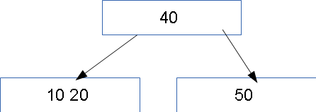
Creation of B Tree of Order 4
Insert 10,20,40,50
When we insert 10,20,40 →
When we try to insert 50, no space so this node is split into two at its median 40 by considering [10,20,40,50]
40 – root
10,20 will be left child
50 will be the right child

Slide 20
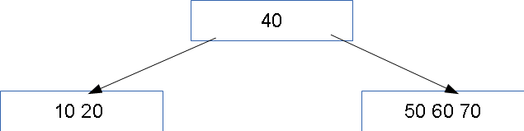
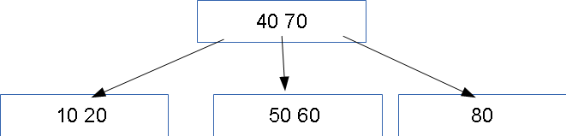
Creation of B Tree of Order 4
Insert 60,70
When we insert 60 and 70 →
When we try to insert 80, no space so this node is split into two at median 70 by considering [50,60,70,80]
70 – root
50,60 will be left child
80 will be the right child

Slide 21

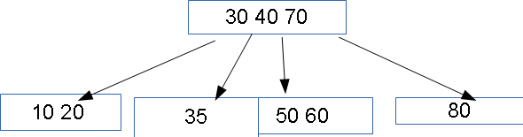
Creation of B Tree of Order 4
Insert 30
When we insert 30 →
When we try to insert 35, no space so this node is split into two at 30 by considering [10,20,30,35]
30 – will goto root
10,20 will be left child
35 will be the right child

Slide 22
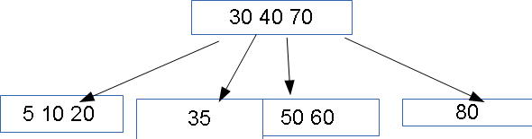
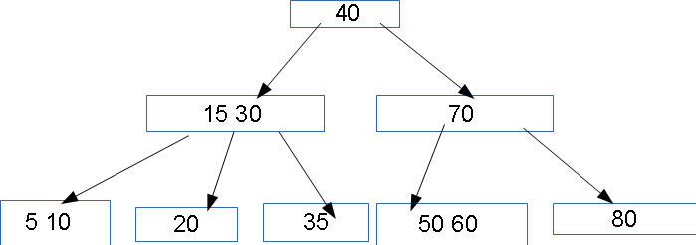
Creation of B Tree of Order 4
Insert 5
When we insert 5 →
When we try to insert 15, no space so this node is split into two at 15 by considering [5,10,15,20]
15 – will goto root
5,10 will be left child
20 will be the right child
In the root no space
When we try to insert 15, no space so this node is split into two at 40 by considering [15,30,40,70]
15, 30 – left
20 - right

Slide 23
Different cases for Deletion
Case 1: The key is in a leaf , which has more than the minimum number of keys. If subset[i] has extra entries, then just delete the data
Delete 21
MIN = 2
MAX = 4
6, 17
6, 17
2, 4
10,13
19, 21, 22
2, 4
10, 13
19, 22

Slide 24
Deletion
Case 2: Key is in a leaf which has just the minimum number of keys. If subset[i-1] has extra entries, then transfer the entry to subset[i]
Delete 22
MIN = 2
MAX = 4
6, 17
6, 15
2, 4
10, 12, 15
19,22
2, 4
10, 12
17, 19

Slide 25
Deletion (cont.)
Case 3: If subset[i+1] has extra entries, then transfer the entry to subset[i] (Similar to Case 2)
Delete 13
MIN = 2
MAX = 4
6, 17
6, 19
2, 4
10,13
19, 21, 22
2, 4
10, 17
21, 22

Slide 26
Deletion (cont.)
Case 4: The key is in a leaf and the leaf and its siblings have just the minimum number of keys. Combine subset[i] with subset[i-1]
Delete 22
6, 17
6
2, 4
10, 12
19,22
2, 4
10, 12, 17, 19

Slide 27
Deletion (cont.)
Case 5 : key is in an internal node. Child node that has the successor of the key is located and if this node has more entries, then the key to be deleted is replaced by the successor and that value in the leaf is deleted.
Delete 95
62
25, 45
85,95
15,20
50, 54
97,100,150
75, 80
90 , 92
30,40

Slide 28
Contd. Case 5
62
25, 45
85,97
15,20
50, 54
100,150
75, 80
90 , 92
30,40

Slide 29
Summary
B-Tree
Insertion into B-Tree
Deletion from B-Tree

